Slide 1
Natural Language Processing Using Large Language Models
Author: Chetan Bhanushali

Slide 2
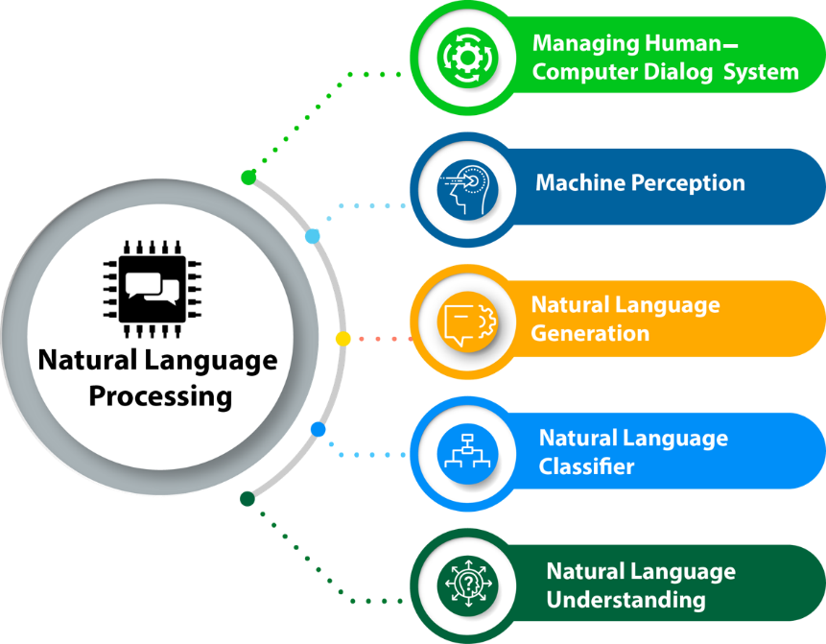
What is NLP?
Natural Language Processing (NLP) is a field of artificial intelligence (AI) that focuses on enabling computers to understand, interpret, and generate human language in a way that is both natural and meaningful.
But how does this happen?

Slide 3
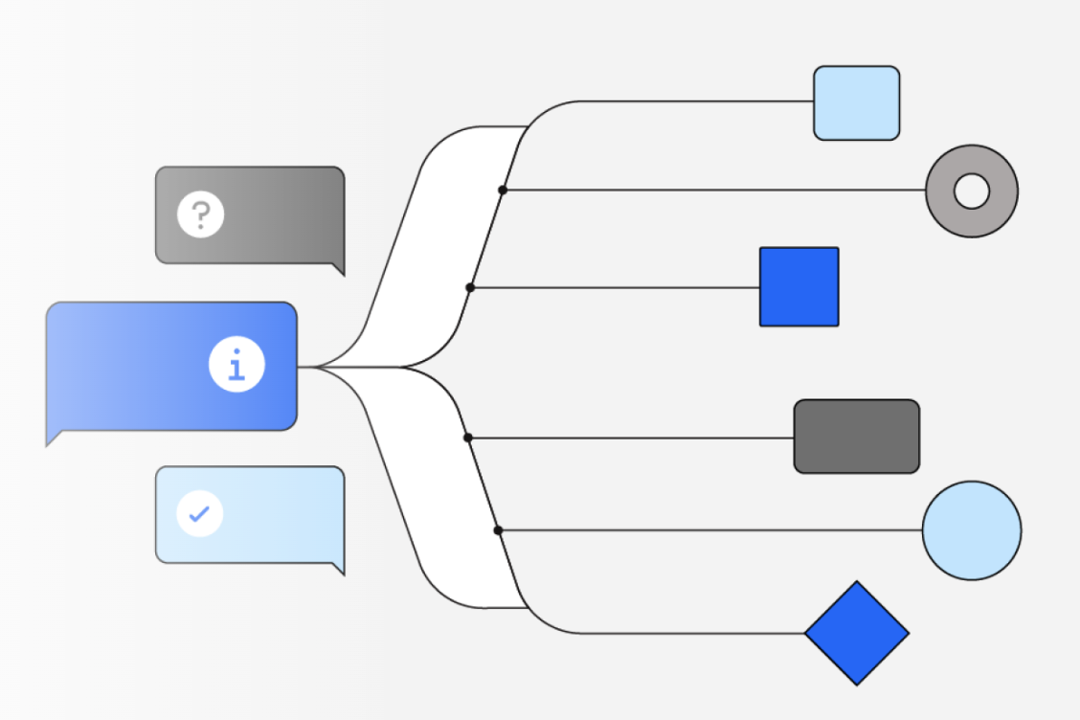
What are LLMs?
Large language models (LLMs) are sophisticated artificial intelligence models designed to understand and generate human-like text. These models are built using deep learning techniques, particularly using architectures like transformer neural networks. The term "large" refers to the immense size of these models, both in terms of the number of parameters and the amount of training data they are trained on.
Some popular examples of large language models include OpenAI's GPT (Generative Pre-trained Transformer) series, as well as models developed by Google (BERT, T5), Facebook (RoBERTa).

Slide 4
Project Proposal
The vision of this project is to leverage NLP and LLMs to develop an application where you can provide a .CSV file as input and ask questions to get insightful answers regarding the csv file data.
This means we don't have to spend time writing codes to get the information from csv file. We just need to ask the application to do the work for us.

Slide 5
Technology Used
IDE: Jupyter Notebook
Programming Language: Python
Packages used: LangChain, Pandas, OpenAI
LangChain is a framework for developing applications powered by large language models (LLMs).
LangChain simplifies every stage of the LLM application lifecycle:
Development: Build your applications using LangChain's open-source building blocks and components.
Productionisation: Use LangSmith to inspect, monitor and evaluate your chains, so that you can continuously optimize and deploy with confidence.
Deployment: Turn any chain into an API with LangServe.

Slide 6
LangChain
Important components of LangChain:
Models, Prompts and Output Parsers
Memory
Chains - Chain usually combine an LLM together with prompt. You can combine many chains to perform different operations on you data.
Agents - Agents are responsible for carrying out the basic task of this application. We can combine agents with tools(math, wikipedia) or custom functions to make it more powerful.

Slide 7
Application Flow
Let’s jump to code.
Download dependencies and import packages
Create OpenAI key & Set Environment Variables
Import .csv file and store in panda df
Upload df to SQL database
Get answers
Prompt questions to agent
Define agent and feed the df to agent

Slide 8
Future work and scope
With this cutting edge application we are able to reduce the coding time to find insightful information about the data. Moreover, the application is easy to use for anybody who can write prompts/questions.
Future work includes creating a GUI and handling more complex questions which will require merging multiple chains and implementing custom tools.

Slide 9
Thank you

